Slide 1
Bunch Detection using YOLO and FasterRCNN Deep Learning Architectures
Master’s Degree in Computer Science and Engineering
Computer Vision & Deep Learning (2022/2023)
Davide Camponogara VR472108

Slide 2
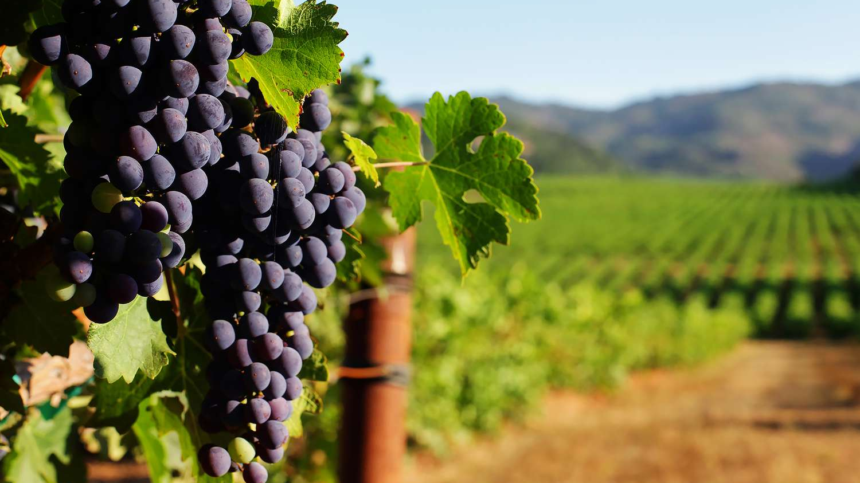
AI in viticulture
The use of artificial intelligence technologies in the agronomy is becoming more and more important.
Deep neural network can now be trained on large datasets of many different types of crops, with excellent results.
Field owners can now monitor the health and growth of their land, increasing productivity.

Slide 3
Datasets and Data Augmentation

Slide 4
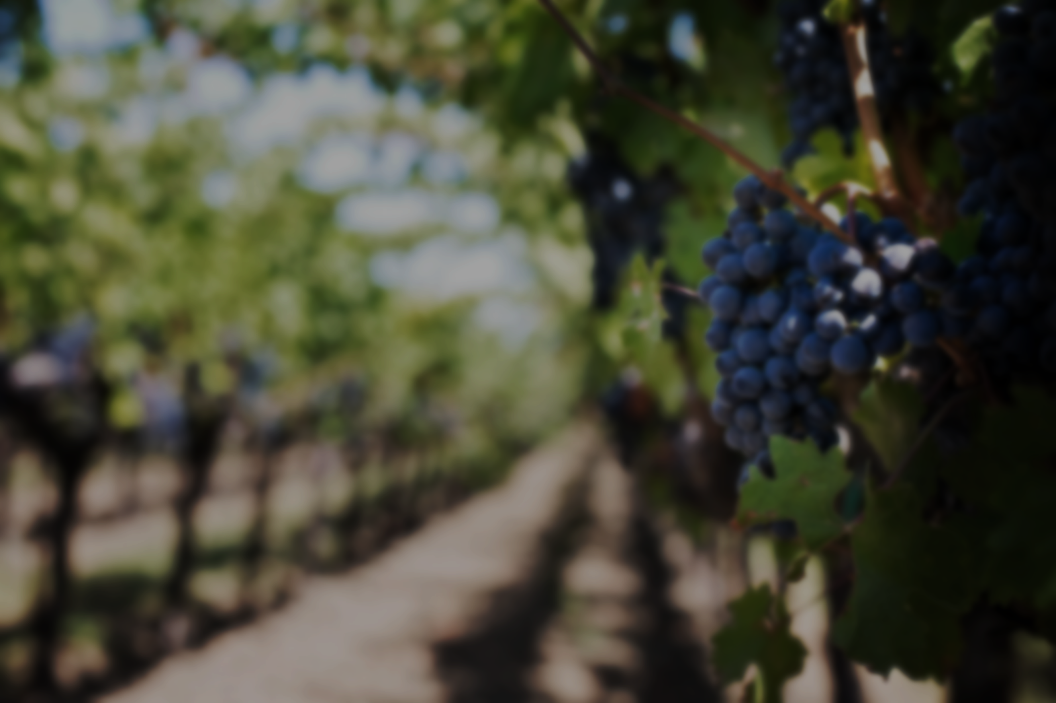
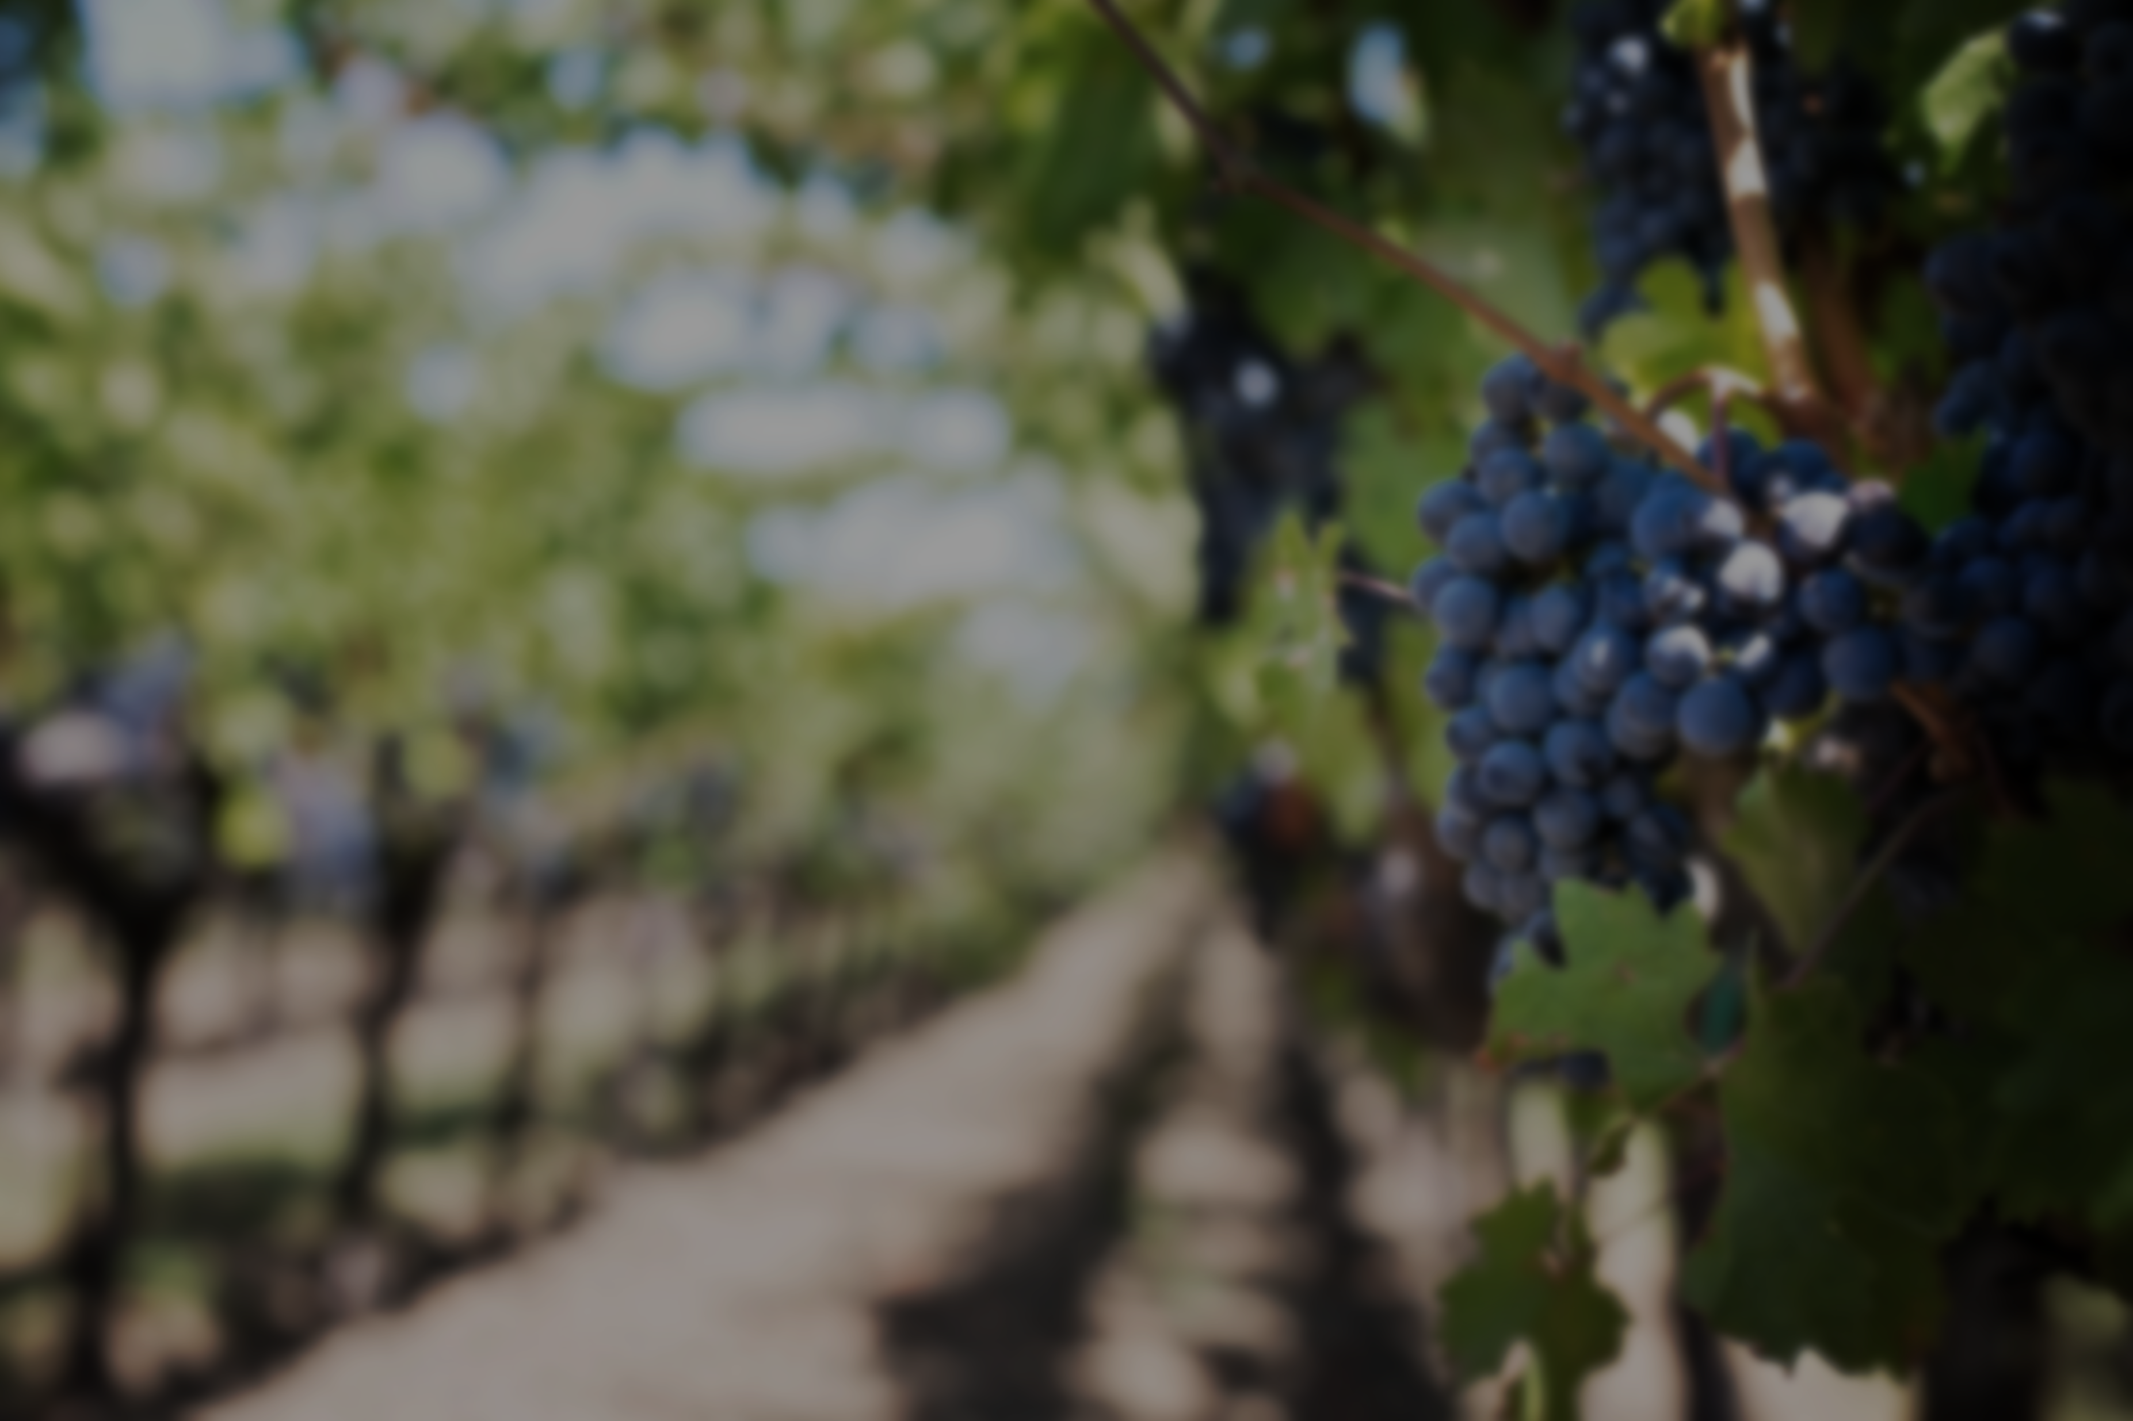
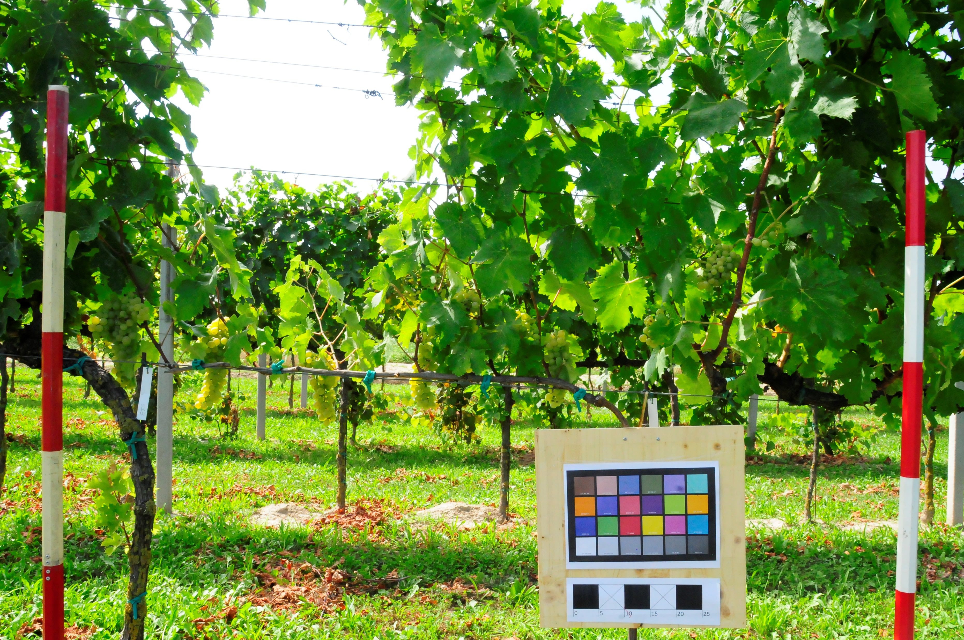
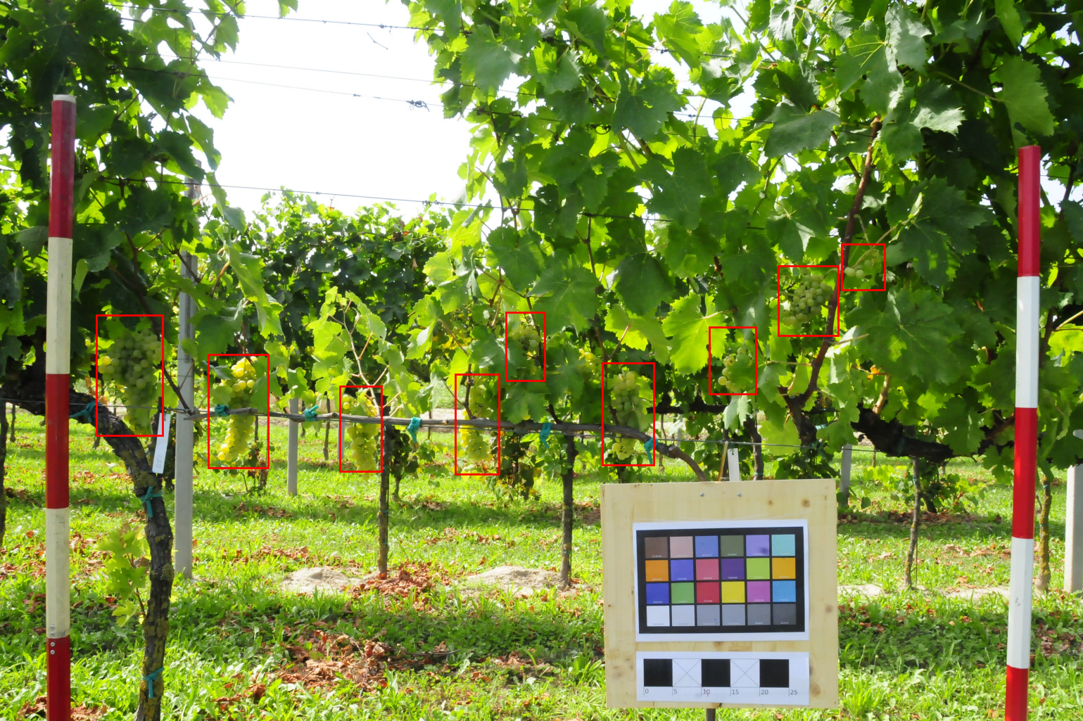
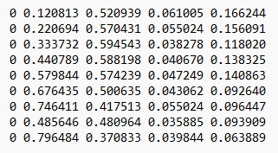
wGrapeUNIPD-DL Dataset
This dataset contains 373 images acquired from later view in vertical shoot position vineyards in six different Italian locations at different phenological stages. 270 images also have the YOLO labels.

Slide 5
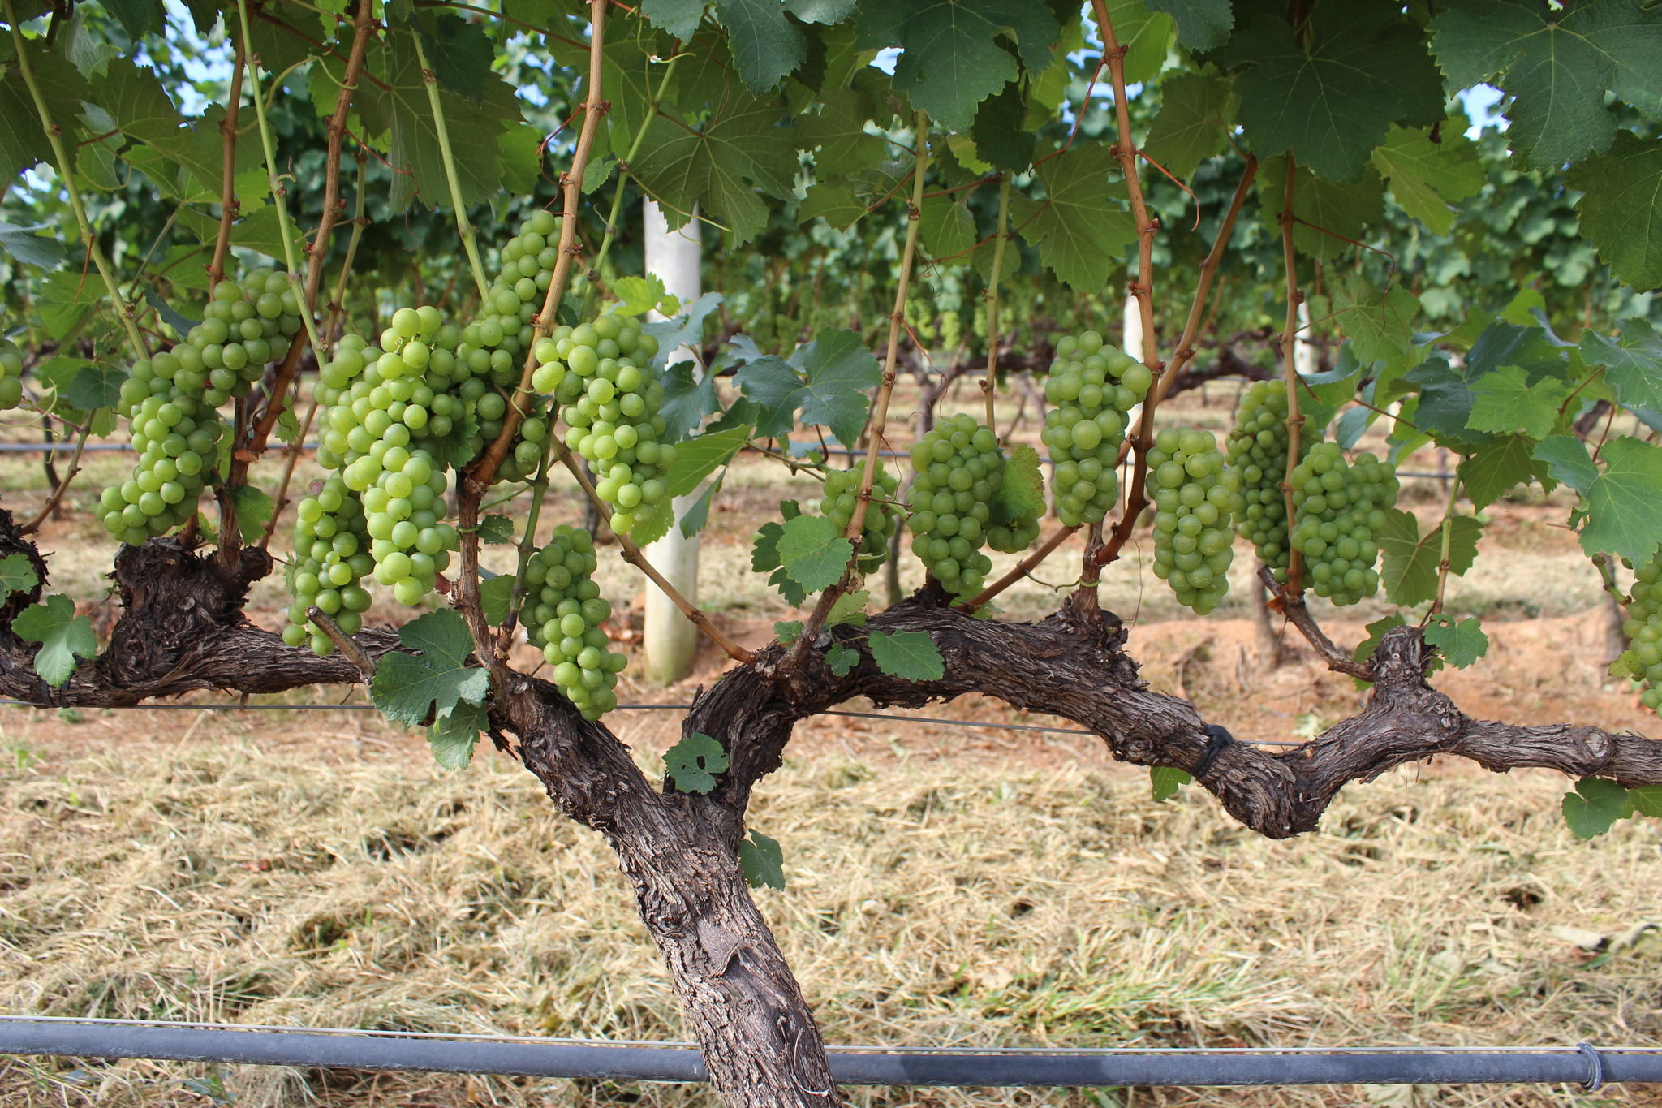
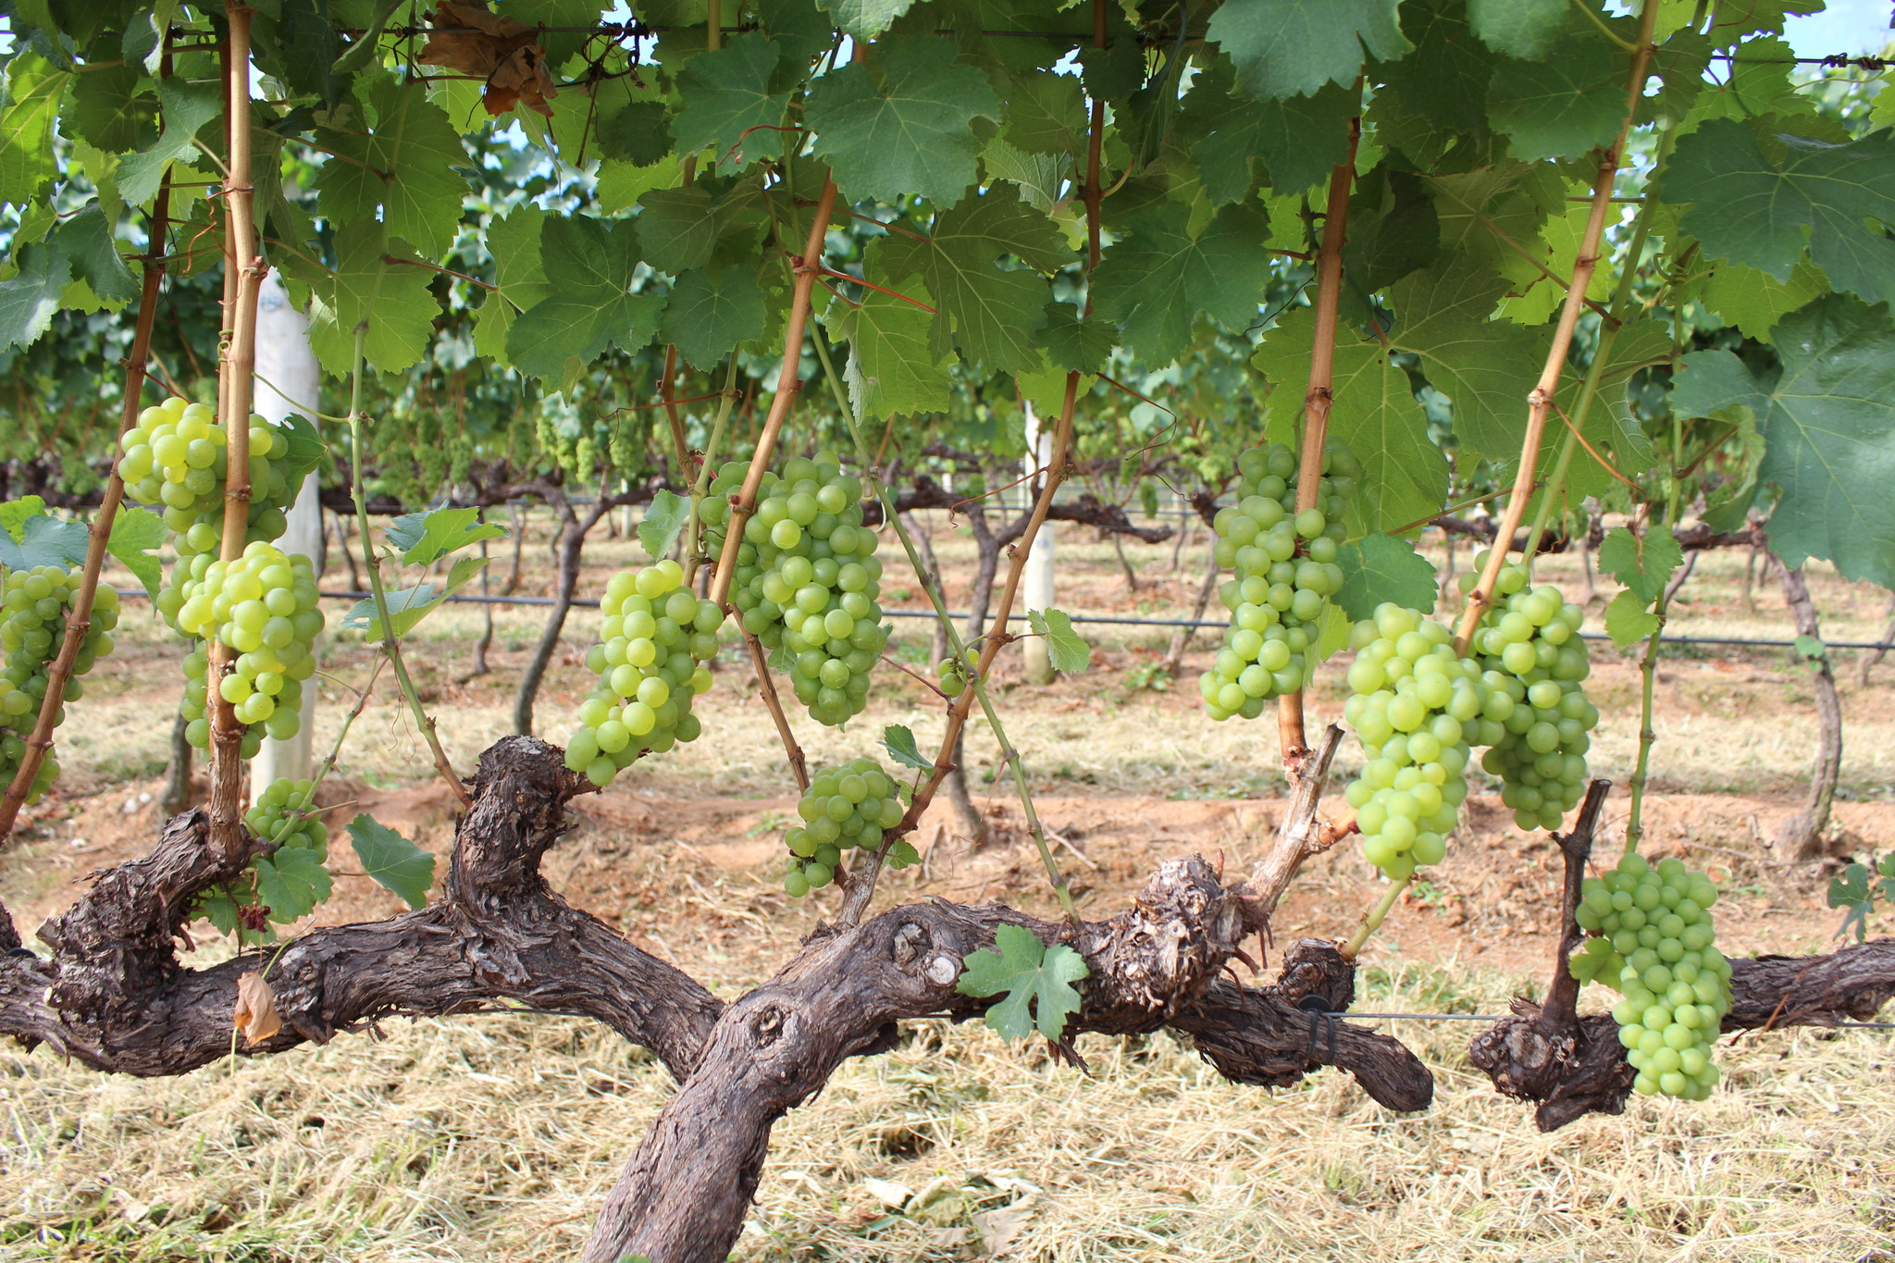
WGISD Dataset
This dataset contains 300 images, these images show bunches more clearly than the wGrapeUNIPD dataset. Often the bunches are zoomed and you can see the grapes in detail.

Slide 6
Data Augmentation Techniques
Importance of data augmentation techniques, mostly in small datasets:
Avoid overfitting;
It increases the model’s ability to generalize;
It improves the accuracy of the deep learning model’s predictions.
We will briefly compare the results with and without data augmentation techniques.

Slide 7
Object Detection and Architectures

Slide 8
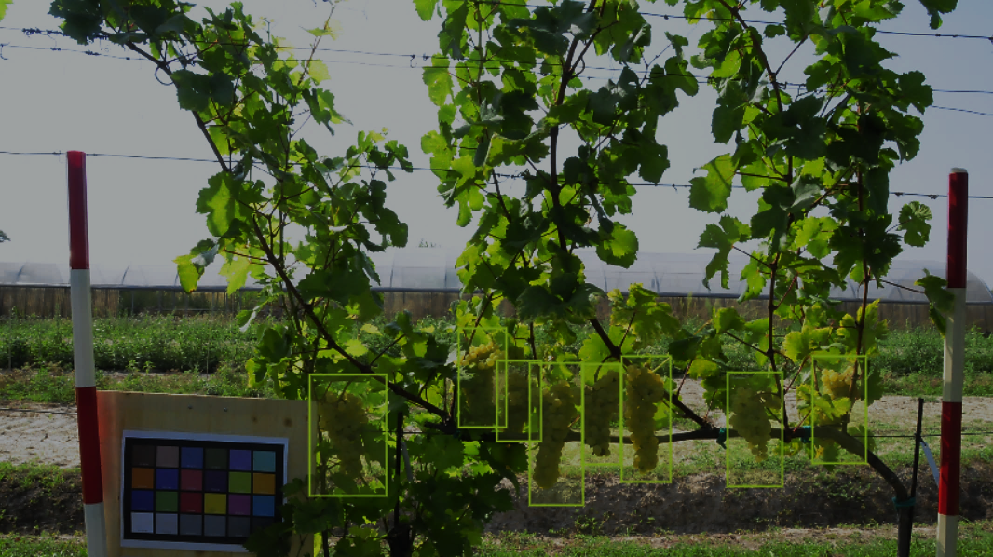
Object Detection in Our Project
The task of assigning a label and a bounding box to a objects in the image.
We compare the different bunch detection strategies, in particular we will focus on FasterRCNN and YOLO architectures.
We want to detect bunches of grape from images.

Slide 9
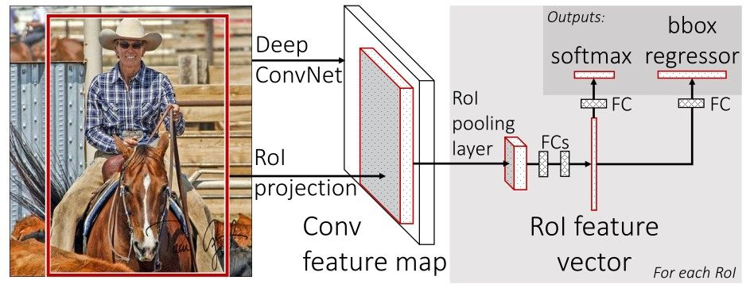
FastRCNN
Two modules:
Deep fully convolutional network as Region Proposal Network (RPN)
Fast R-CNN detector
Attention mechanism:
The RPN module tells the Fast R-CNN module where to look
Feature Pyramid Network:
Takes single-scale image of arbitrary size as input, outputs proportionally sized feature maps

Slide 10
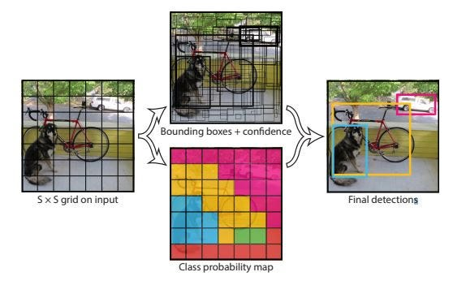
YOLOv5
Predict bounding boxes and classes simultaneously:
Divide image in S x S cells, each cell predict class and bounding boxes;
Non-maximum suppression.

Slide 11
FastRCNN
Training Hyperparameters
YOLOv5
We try to train FasterRCNN with different backbones:
MobileNet
VGG16 - VGG19
ResNet18 – ResNet50 – ResNet101
We train for 5 epochs using SGD optimizer, starting from an aggressive learning rate of 0.005, which descends after 3 epochs to 0.0005, we use batch size of 1.
We resize images to 1216 X 1216 pixels.
We train for 40 epochs using batch size of 16 images and SGD optimizer, starting from an aggressive learning rate of 0.01.
We resize images to 1216 X 1216 pixels.
We tried different parameter combinations, but we got the best results with those described in this slide!

Slide 12
Experiments

Slide 13
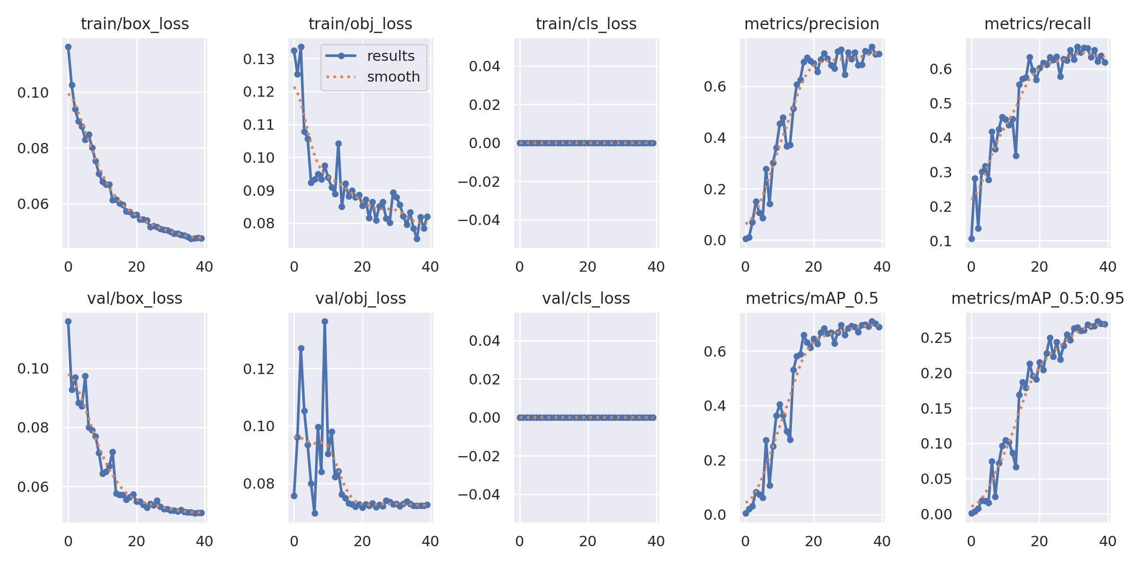
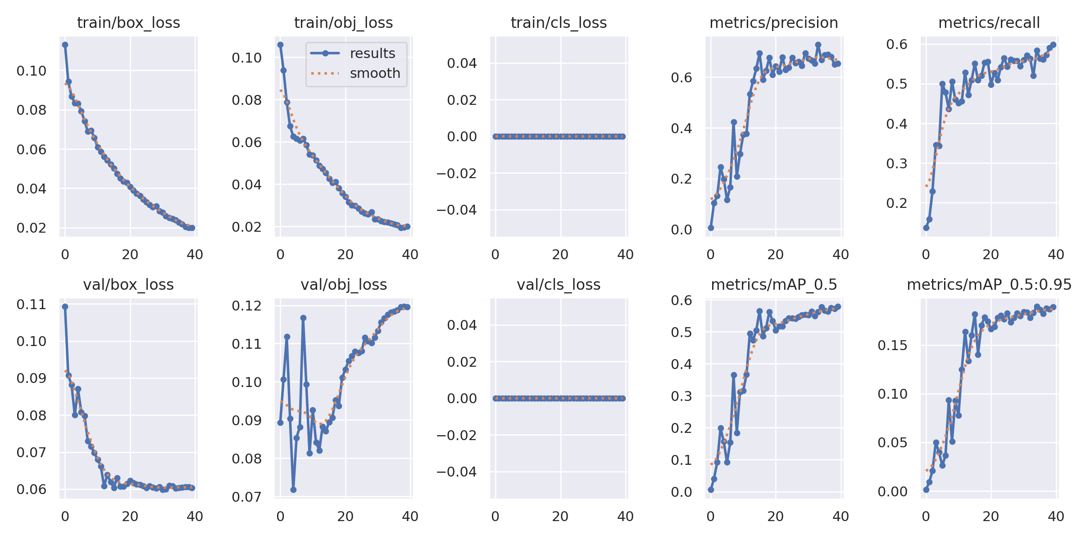
YOLOv5 overfitting
With Data Augmentation
The graphs below enhanced a case of overfitting during the training of the YOLO architecture.
We show the comparison of the different implementations of YOLO, with and without data augmentation.
Without Data Augmentation

Slide 14
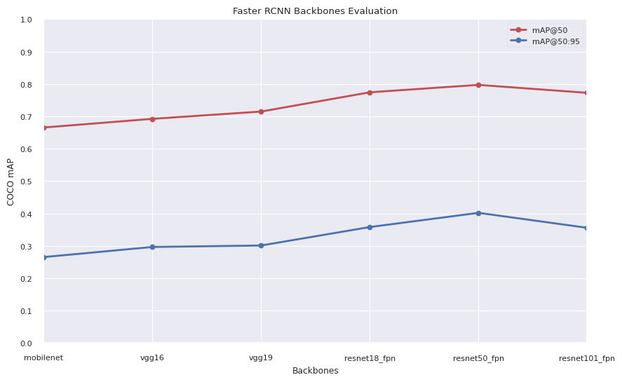
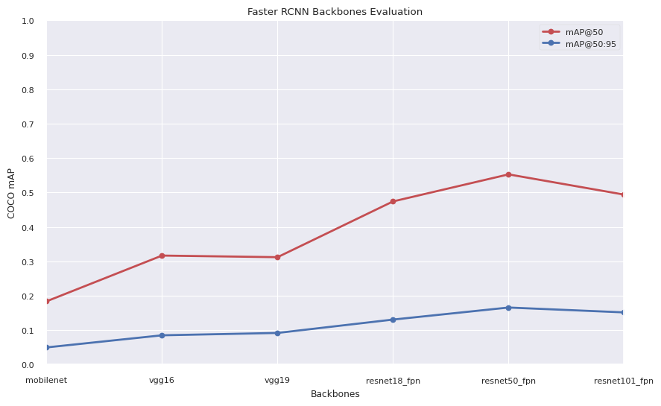
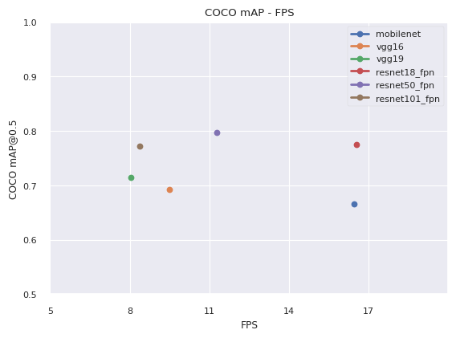
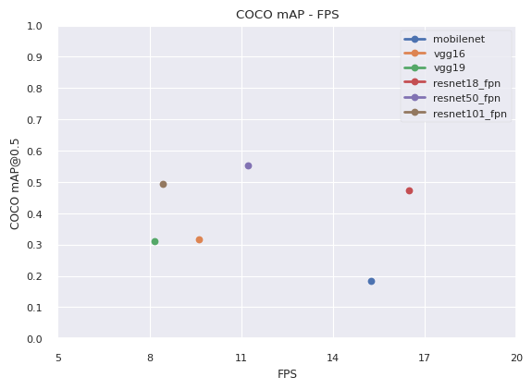
Faster RCNN Backbones Comparisons
In the graphs below we show the different evaluation results obtained with different backbones.
In particular, from top to bottom you find:
mAP comparison in both datasets, with different backbones.
mAP/FPS relation for each backbones.

Slide 15
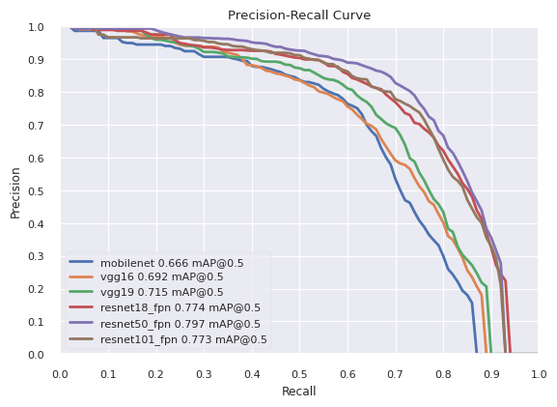
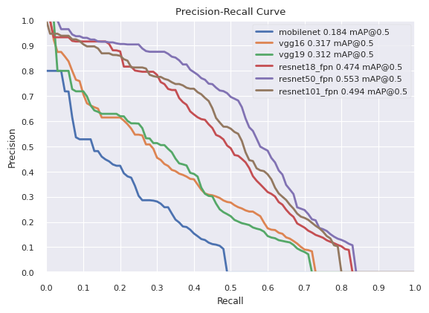
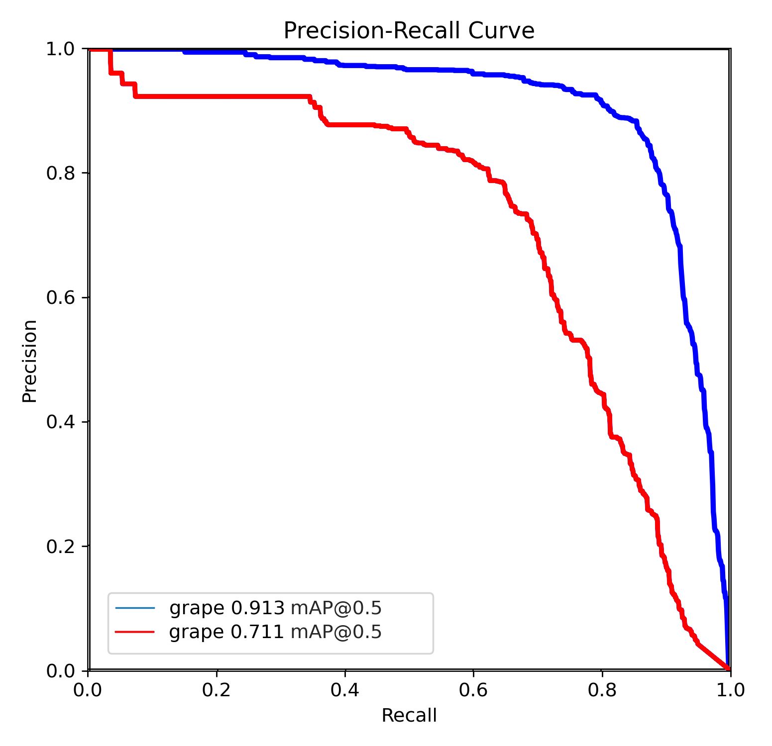
Faster RCNN VS YOLOv5
FasterRCNN on WGISD dataset!
We illustrate the quantitative and qualitative results obtained by using these architectures, we start from PR curves!
We show also the results with different backbones!
FasterRCNN on wGrapeUNIPD dataset!
YOLOv5 on WGISD and wGrapeUNIPD datasets!

Slide 16
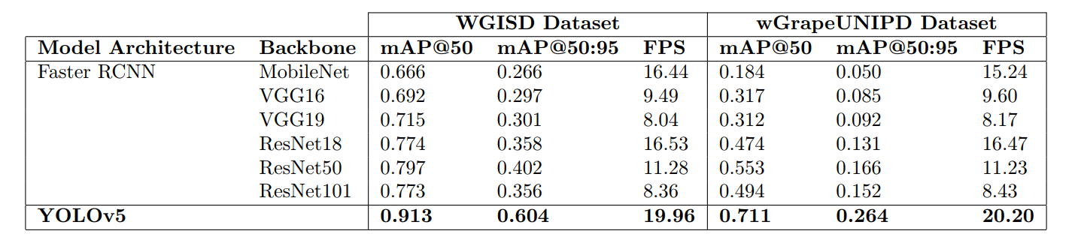
Faster RCNN VS YOLOv5
We continue with a summary table, where we insert also the FPS values obtained by the different algorithms.
YOLOv5 outperforms Faster RCNN with every backbone, also wins in comparison of inference speed.

Slide 17
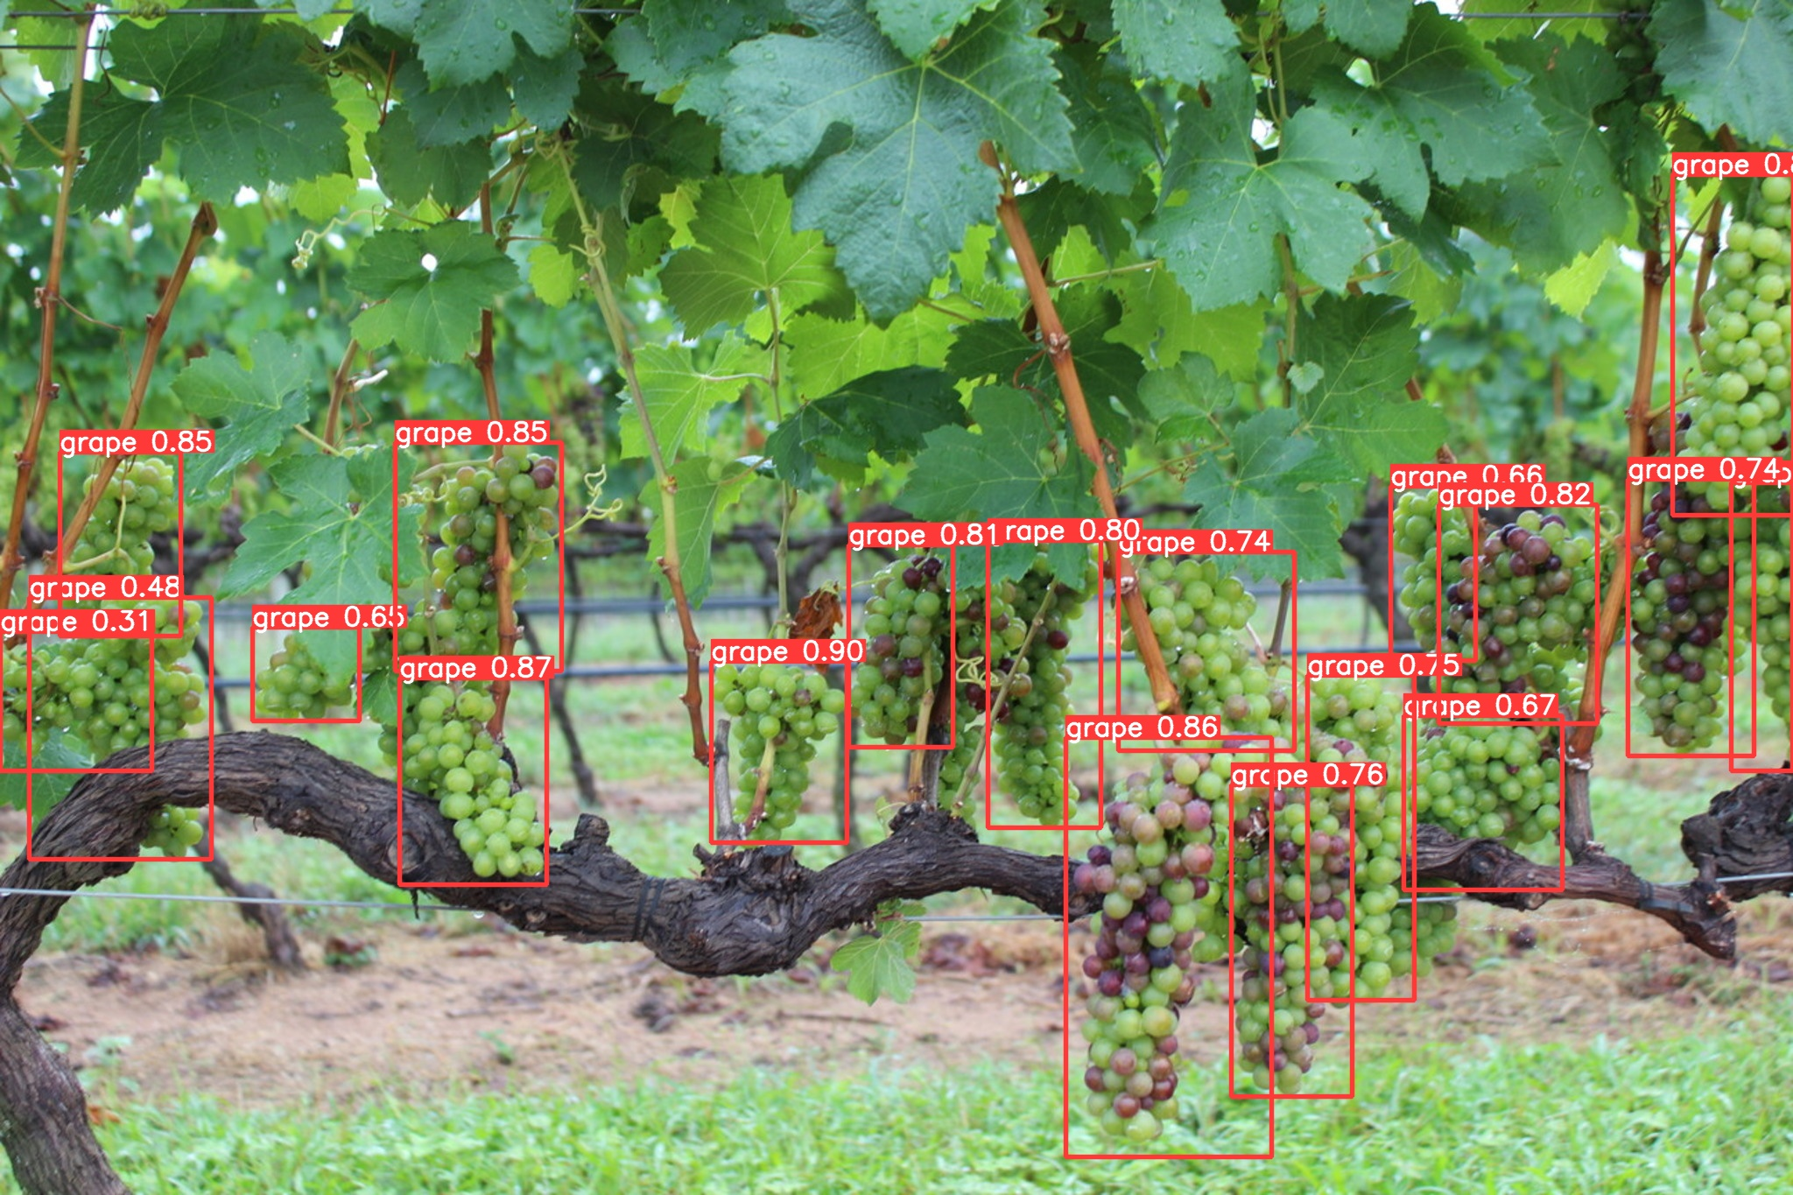
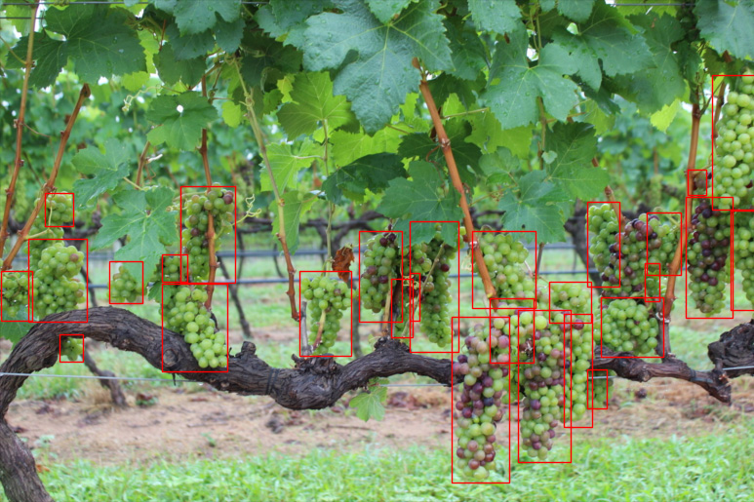
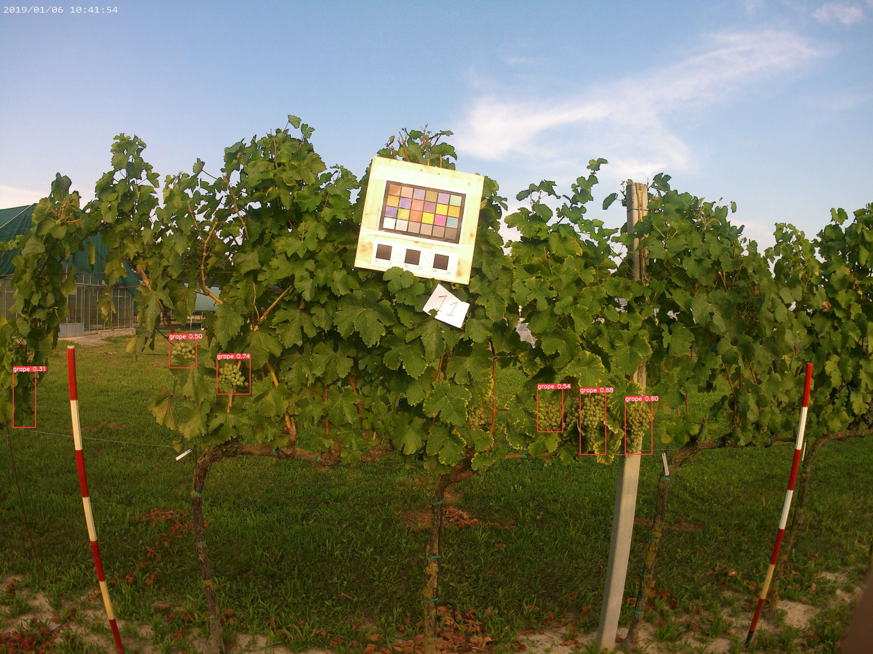
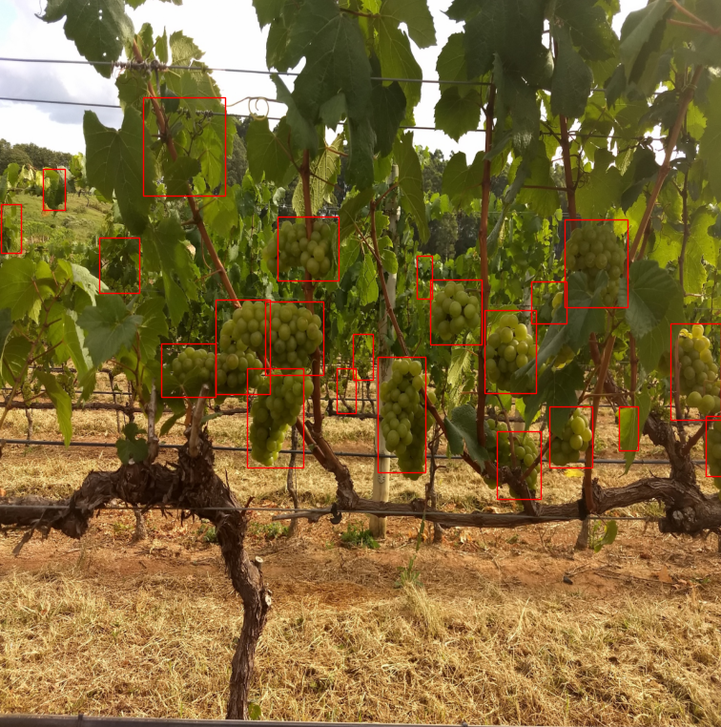
Faster RCNN VS YOLOv5
YOLOv5
Faster RCNN
In this slide we show some tests with both the architectures.

Slide 18
Thanks for your attention!

